Slide 1
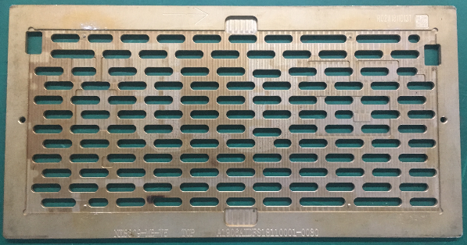
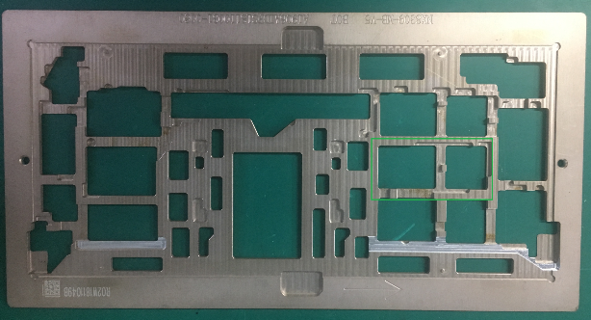
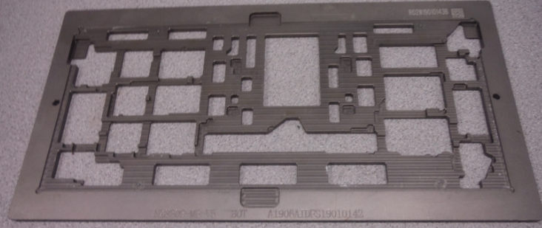
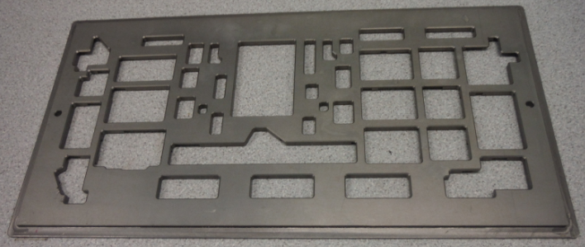
Huaqin reflow pallet for WHL-U
T = 5mm

Slide 2
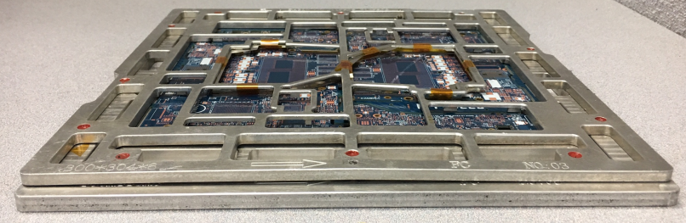
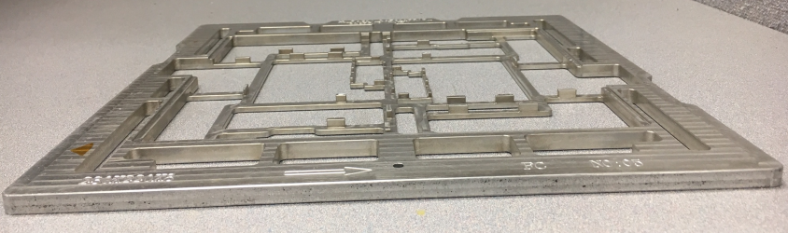
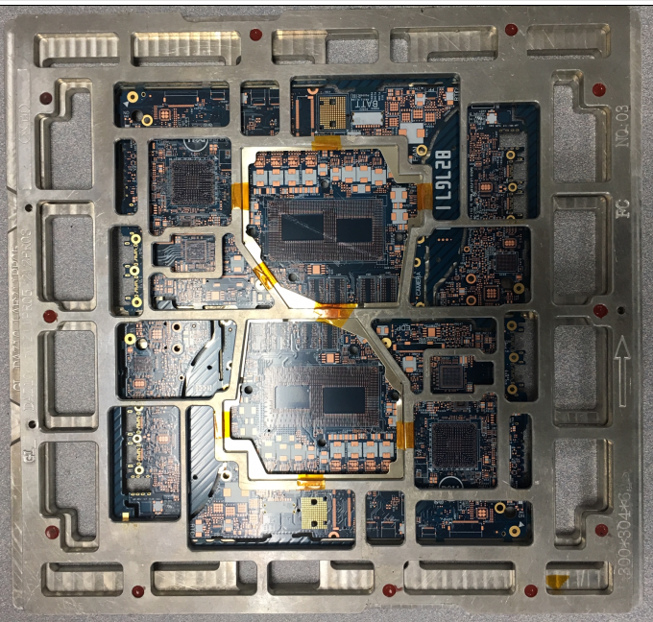
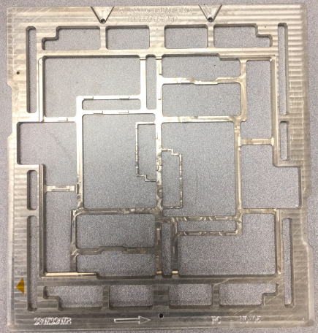
Compal KS reflow pallet for KBL-G
Bottom carrier T= 8mm
Top cover T= 6mm

Slide 3
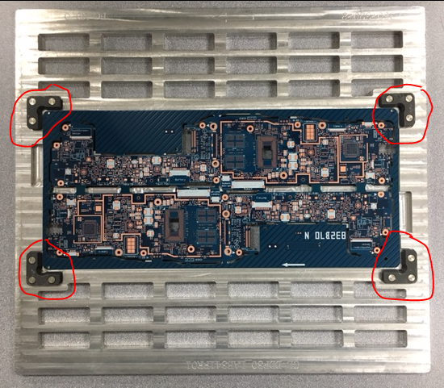
Compal KS reflow pallet for CNL-Y
Pallet w/o top cover

Slide 4
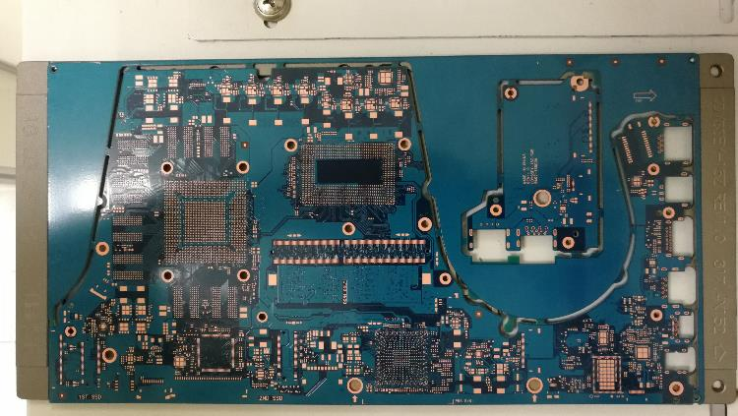
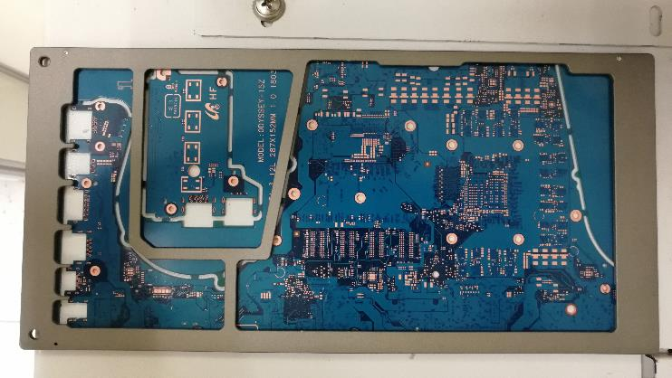
Samsung Suzhou reflow pallet for KBL-H
Top view
Bottom view

Slide 5
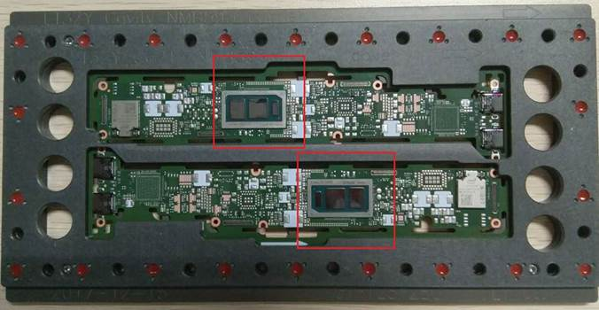
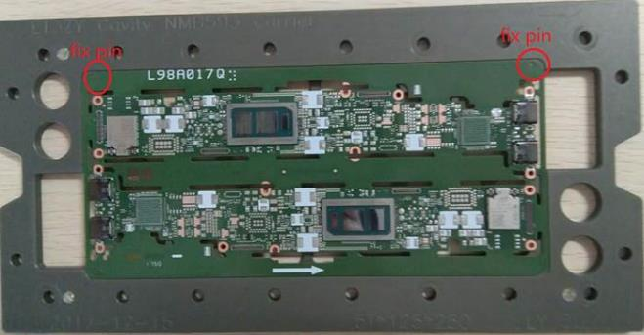
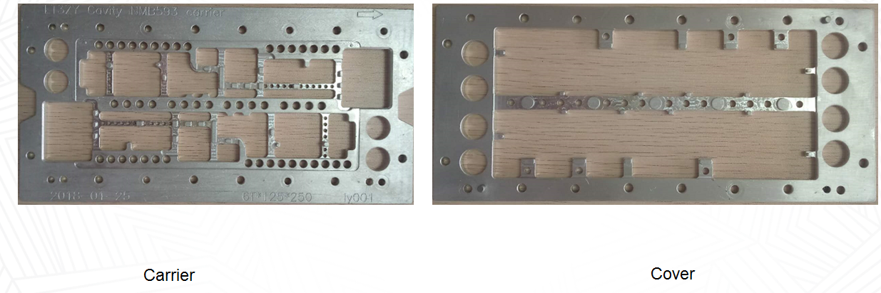
LCFC reflow pallet for CNL-Y

Slide 6
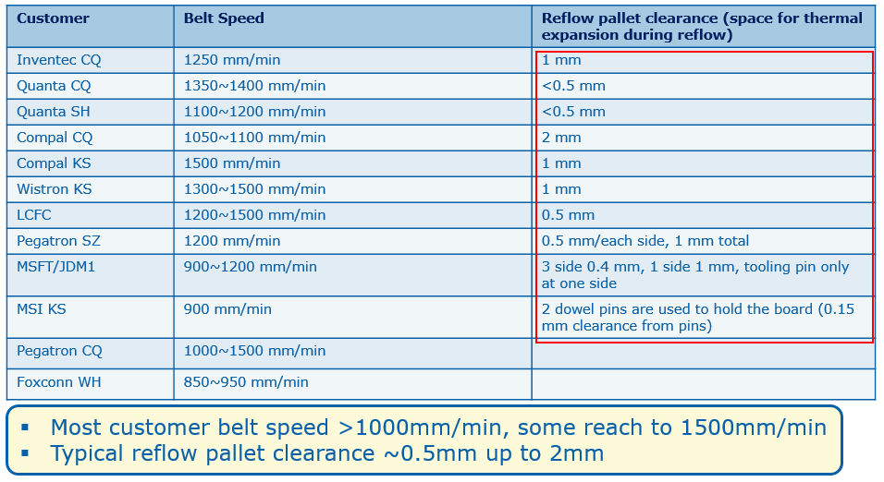
Early 2018 CRD survey data

Slide 7
Observations
  Nowadays, aluminum is the dominating material customers are using for reflow pallet fabrication.
    Other material usage should < 10%
    The pallet thickness is ~5 to 6mm, per CME observation
  Almost nobody use spring clamps because not able to adopt automation process
  Due to thinner PCBs, more and more customer introduce whole process pallet to support PCB (from paste print till reflow), to provide good support to PCB during print, SMT and reflow process
    The whole process pallet requests to use tooling pins and smaller clearance, to hold the PCB position precisely.
  When HVM, most customer use customized pallet to support instead of general pallet, due to the complexity of board shape, size, thickness and component layout

